Slide 1
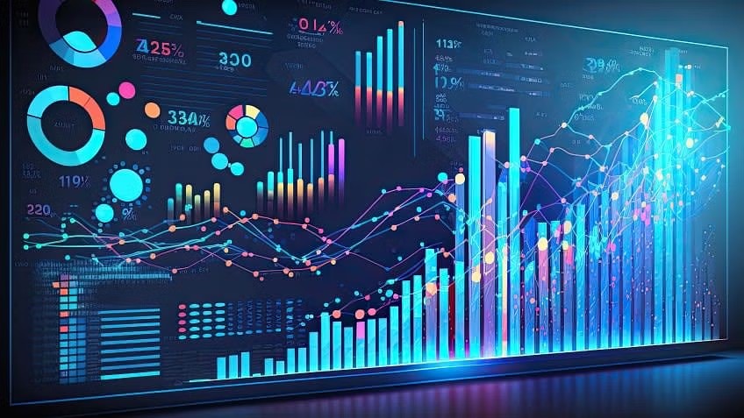

Behavioural Analysis on r/WallstreetBets
Jonathan Gonzalez
Cedric Lam
Hair Albeiro Parra Barrera

Slide 2
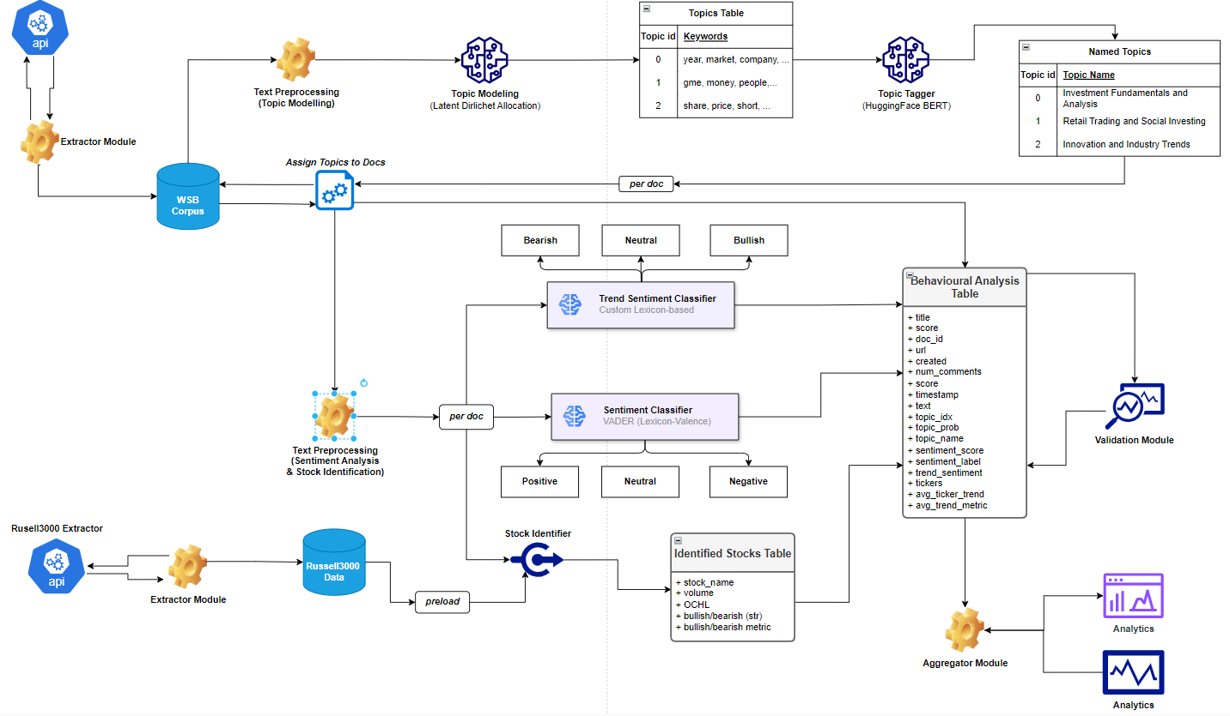
Architecture

Slide 3
Index
Introduction
Tech Stack
Architecture Overview
1. Extractor Module
2. Topic Modelling
3. Topic Tagger
4. Sentiment Analysis
5. Trend Analysis
6. Stock Identification
7. Aggregation
8. Dashboard Analytics

Slide 4

Introduction
Idea: Analyze the behavior and psychology of investors on r/wallstreetbets.

Slide 5
Introduction
Idea: Analyze the behavior and psychology of investors on r/wallstreetbets.
Methods: NLP for behavioral analysis, topic clustering, sentiment analysis, trend analysis, text mining, data analytics, cloud computing.
Dataset: Textual data from posts and comments + financial stock data.
Novelty: In-depth analysis of investor psychology in a uniquely speculative and informal setting, including flagging of potentially new meme stocks.
Expected Output:
Insights into the behavior of retail investors in hype-driven markets.
Model that flags potential meme stocks based on subreddit activity patterns.

Slide 6
















Tech Stack

Slide 7
Architecture

Slide 8
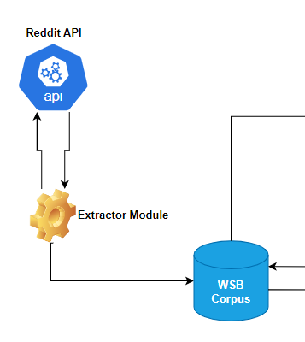
1. Reddit Extraction
Extractor module queries the reddit API
Data gets stored under a local table WSB Corpus
Improvements:
Database indexing

Slide 9
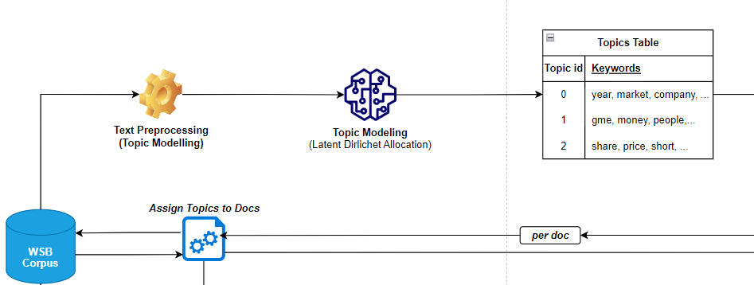
2. Topic Modelling
Corpus: The Wallstreetbets Subreddit recent* posts (title + body)
Custom text preprocessing using NLTK + Spacy + Regex
Topic modelling using Latent Dirichlet Allocation

Slide 10
Topic Modeling
Preprocessing
Hyperlink Removal
Emoji Handling
Tokenization and Lemmatization
Noise Reduction
N-Gram Formation
Special Char Removal

Slide 11
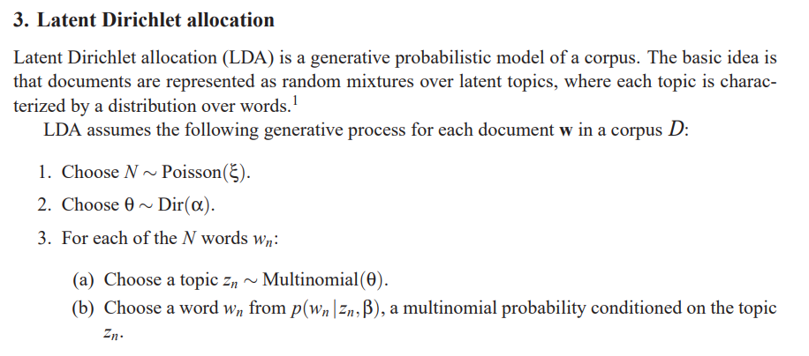
2. Topic Modelling: Latent Dirichlet Allocation
https://www.jmlr.org/papers/volume3/blei03a/blei03a.pdf
Src: https://www.jmlr.org/papers/volume3/blei03a/blei03a.pdf

Slide 12
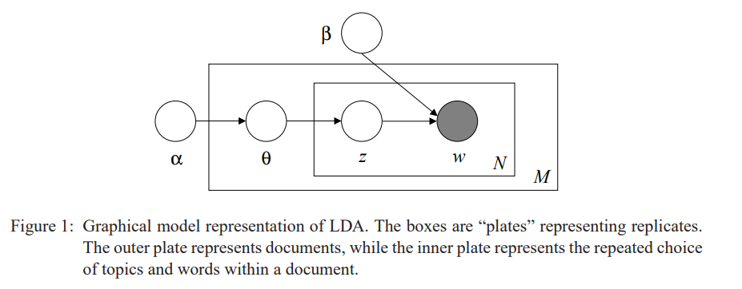
2. Topic Modelling: Latent Dirichlet Allocation
https://www.jmlr.org/papers/volume3/blei03a/blei03a.pdf
Src: https://www.jmlr.org/papers/volume3/blei03a/blei03a.pdf

Slide 13
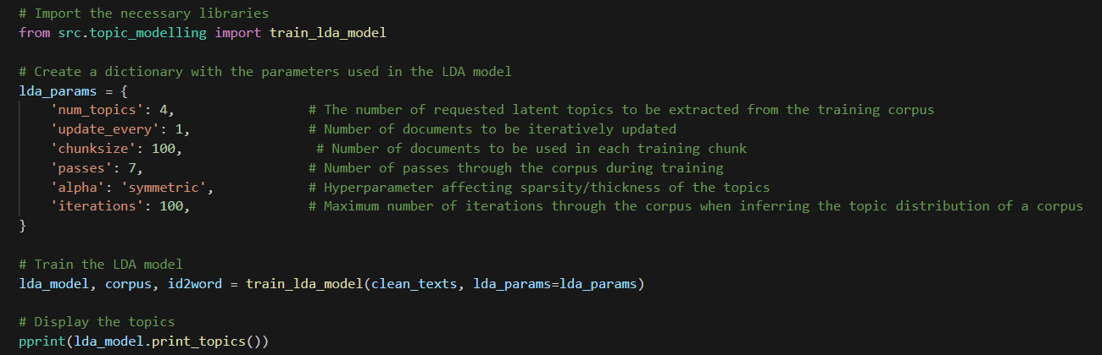
2. Topic Modelling: Latent Dirichlet Allocation
https://www.jmlr.org/papers/volume3/blei03a/blei03a.pdf
Src: https://www.jmlr.org/papers/volume3/blei03a/blei03a.pdf

Slide 14
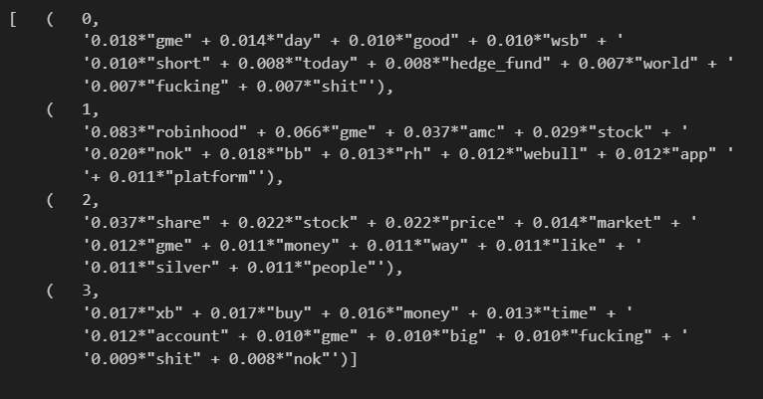
2. Topic Modelling: Latent Dirichlet Allocation
https://www.jmlr.org/papers/volume3/blei03a/blei03a.pdf
Src: https://www.jmlr.org/papers/volume3/blei03a/blei03a.pdf

Slide 15
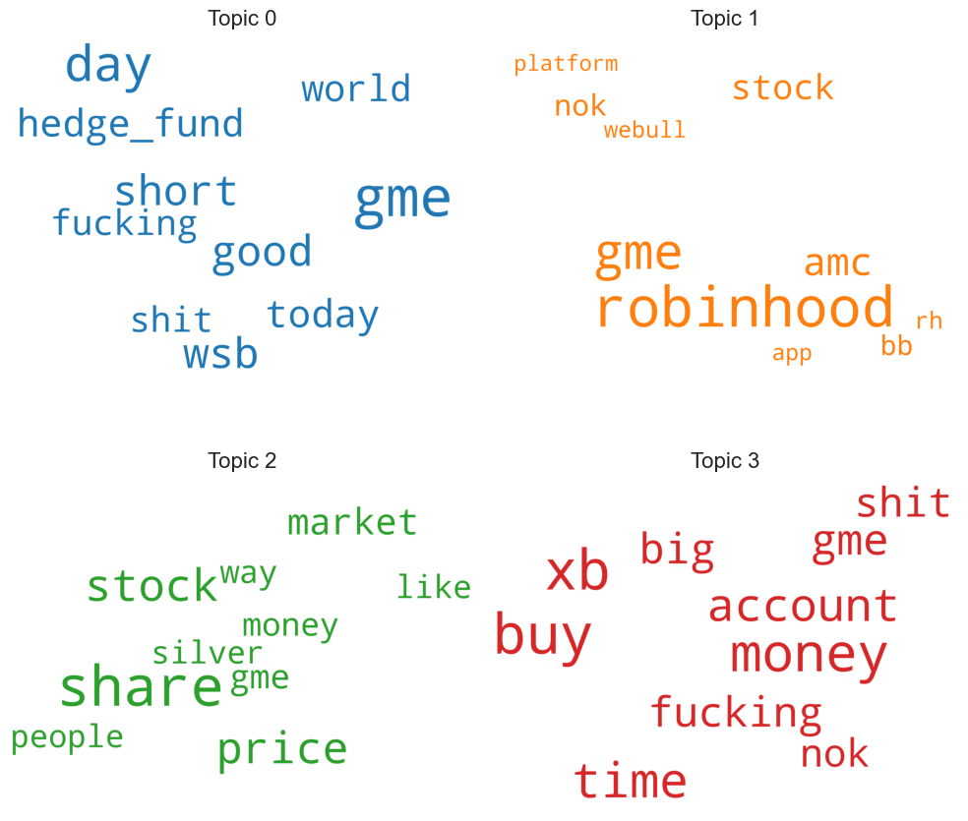
2. Topic Modelling: Latent Dirichlet Allocation
https://www.jmlr.org/papers/volume3/blei03a/blei03a.pdf

Slide 16
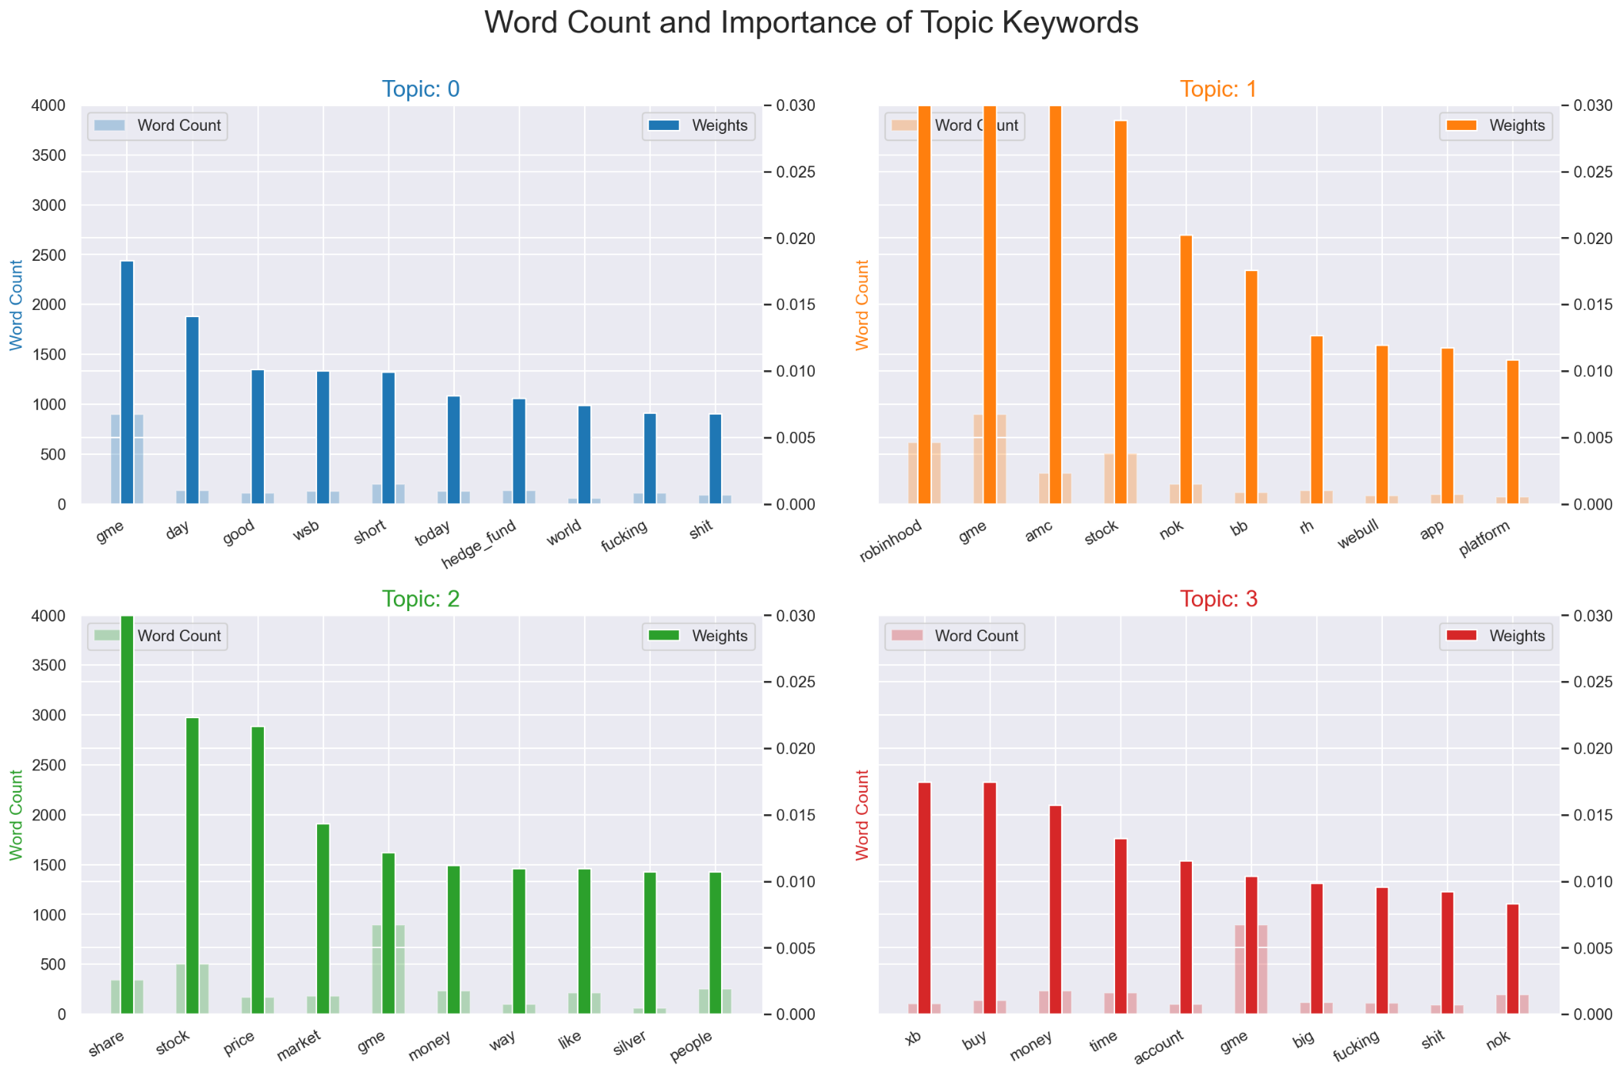
2. Topic Modelling: Latent Dirichlet Allocation

Slide 17
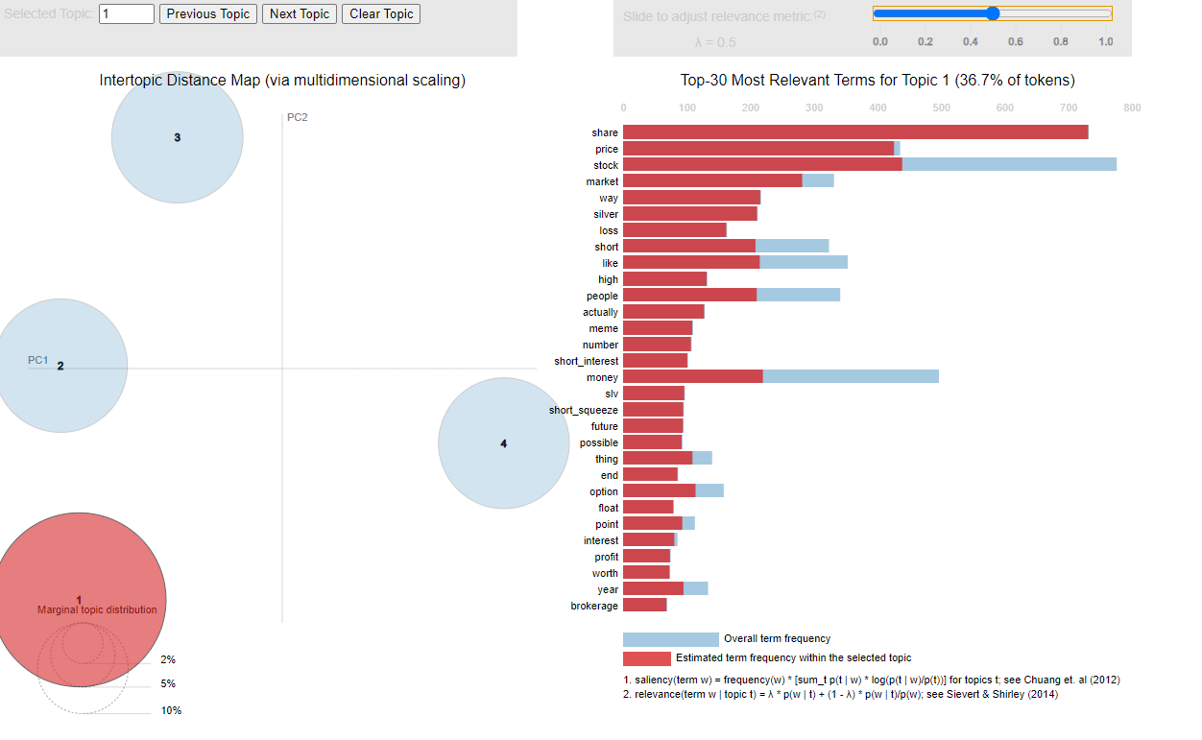
2. Topic Modelling: Latent Dirichlet Allocation

Slide 18
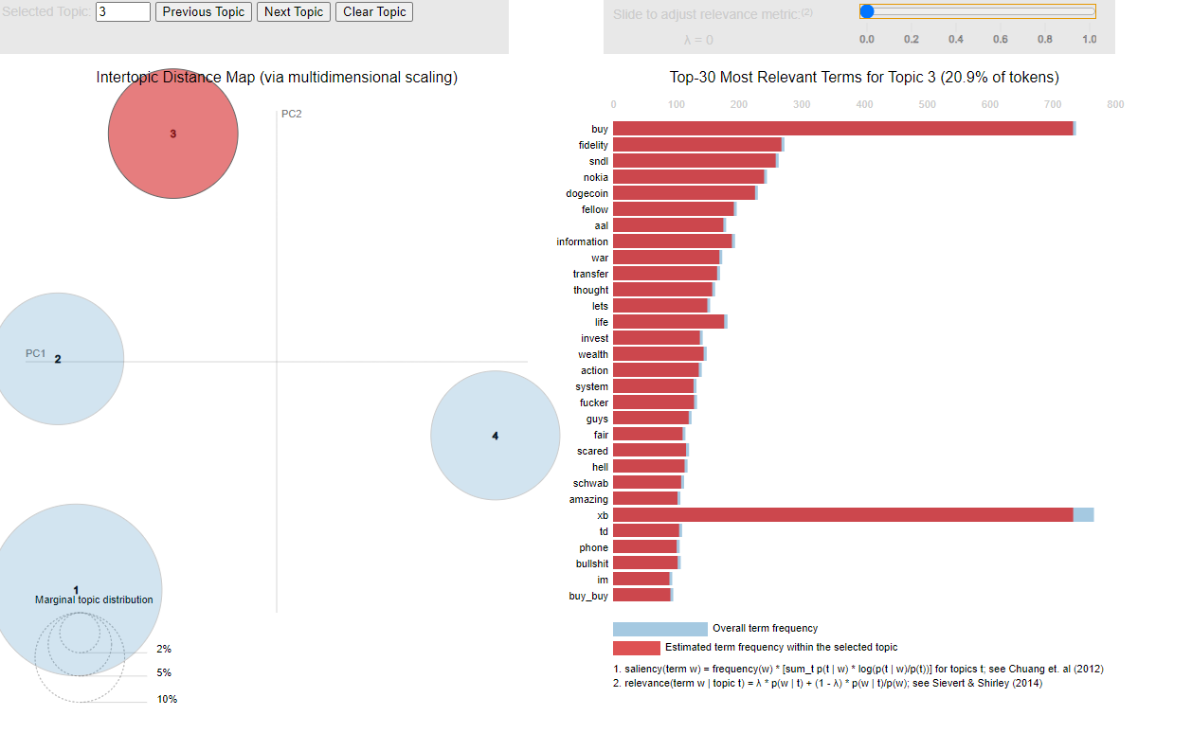
2. Topic Modelling: Latent Dirichlet Allocation

Slide 19
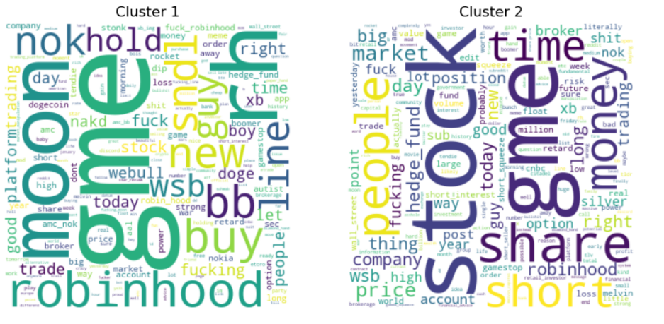
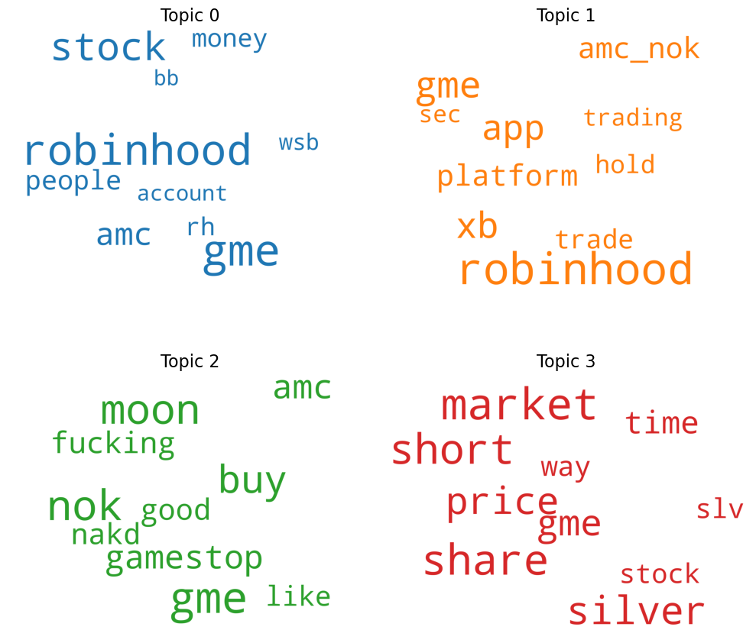
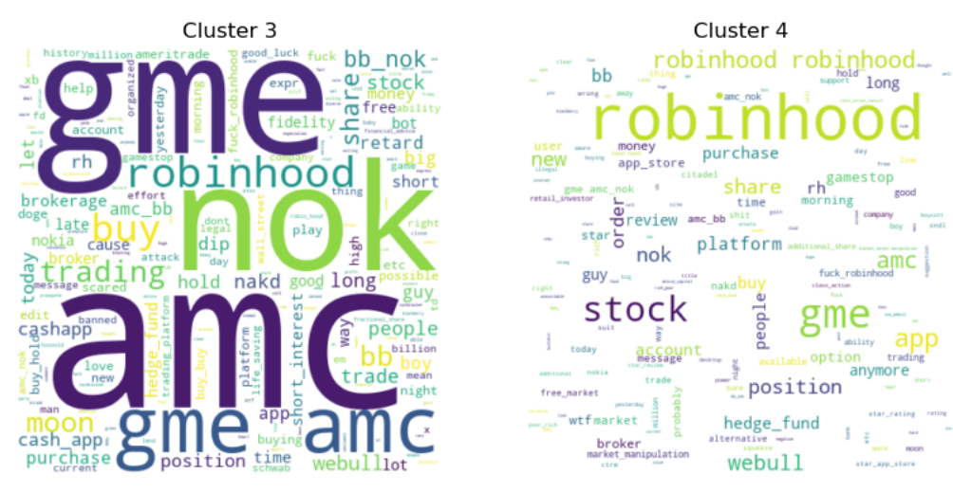
2. Topic Modelling: Baseline comparison
Baseline model: TF-IDF + K-Means Clustering
Our Model: LDA Topic modelling
TFIDF + K-Means
LDA Topic Modelling

Slide 20
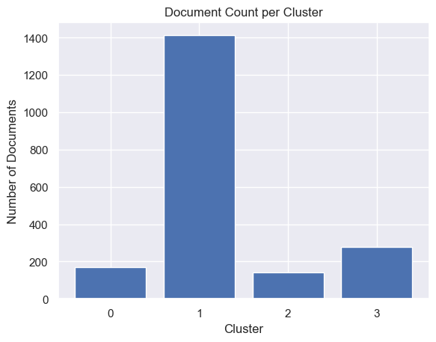
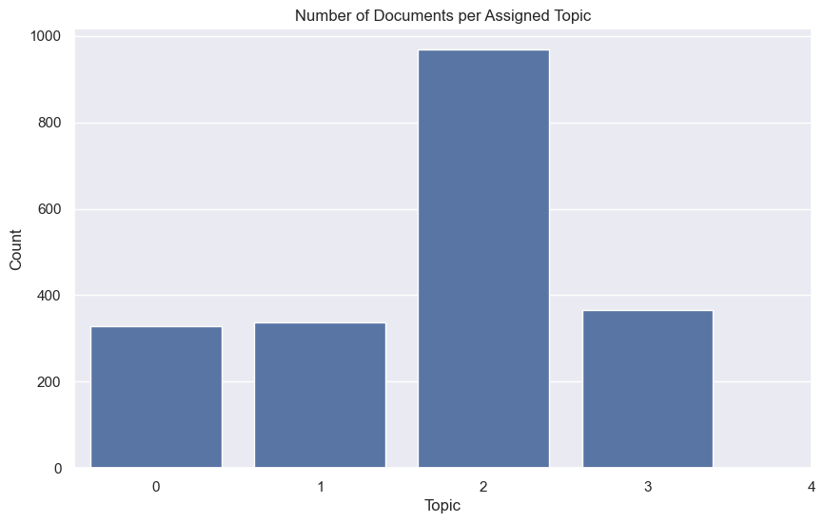
2. Topic Modelling: Baseline comparison
Baseline model: TF-IDF + K-Means Clustering
Our Model: LDA Topic modelling
TFIDF + K-Means
LDA Topic Modelling

Slide 21
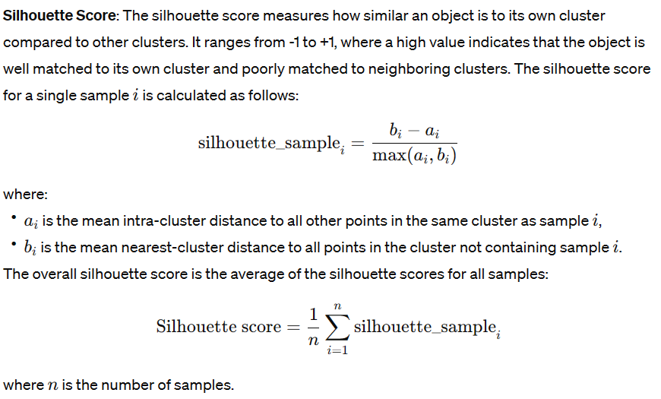
2. Topic Modelling: Baseline comparison
Src: Wikipedia

Slide 22
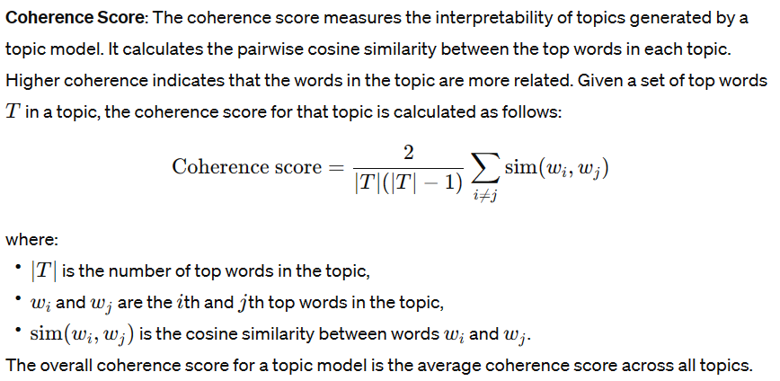
2. Topic Modelling: Baseline comparison
Src: Relativity One

Slide 23
2. Topic Modelling: Baseline comparison
Sample: 2000 texts from fixed dataset.
Metrics:
Silhouette Score:
TFIDF + K-Means: ~0.01318
LDA Topic Modelling: ~0.56020 → More consistent clusters
Coherence Metric:
TFIDF + K-Means: ~0.001613
LDA Topic Modelling: ~0.36249 → More interpretable clusters

Slide 24
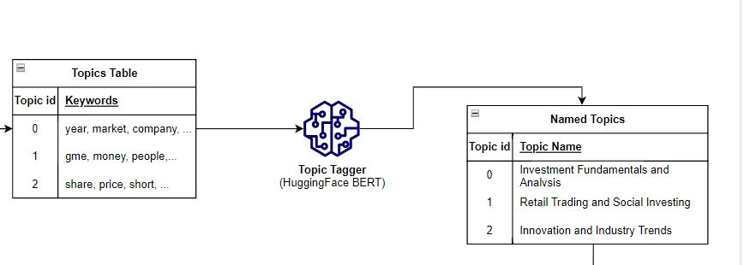
3. Topic Tagger
Input: Topic mixture list of words for each topic.
Classification Model: Pretrained zero-shot LLM classifier via HuggingFace interface:
MoritzLaurer/DeBERTa-v3-base-mnli-fever-anli
Preselected topic labels

Slide 25
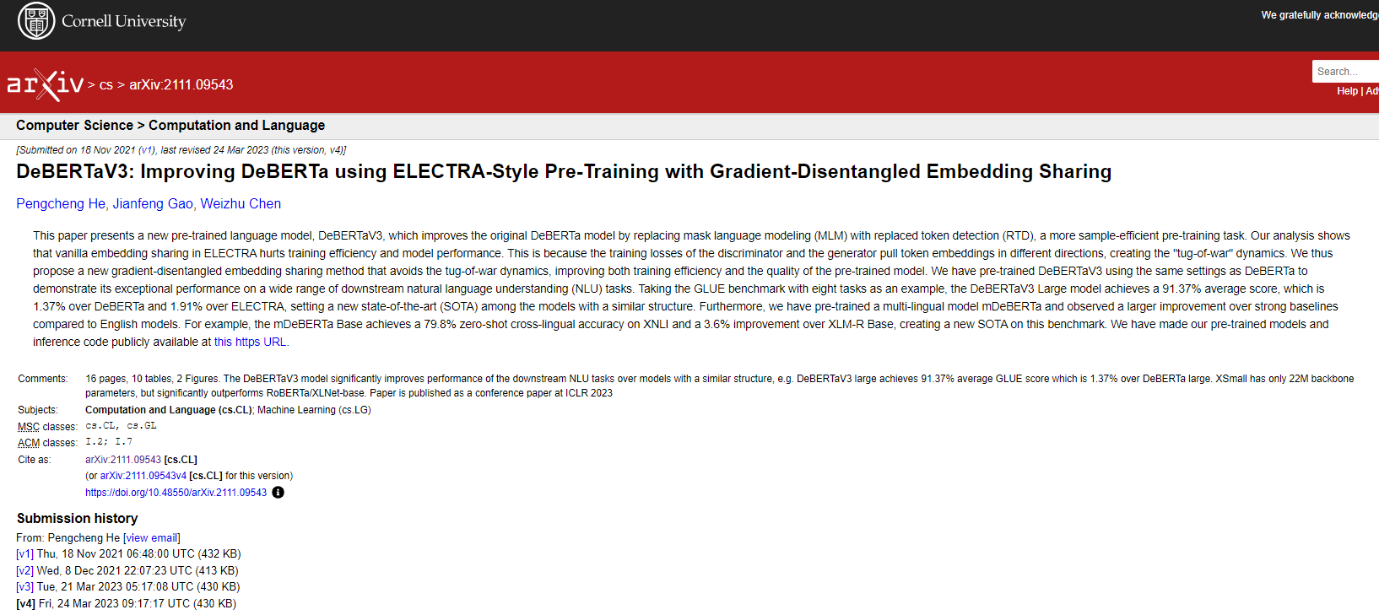
3. Topic Tagger

Slide 26
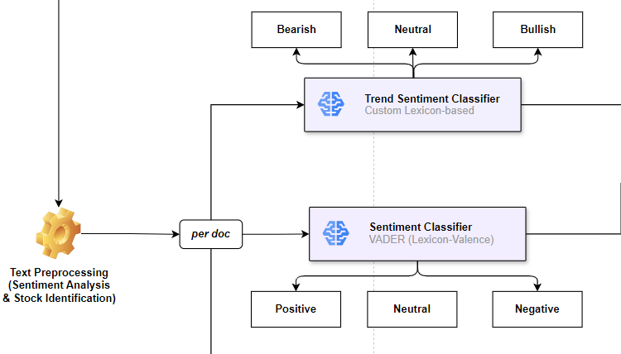
4 & 5. Sentiment & Trend Analysis

Slide 27
4. Sentiment and Trend
Preprocessing
Hyperlink Removal
Emoji Handling
Tokenization
Special Char Removal*

Slide 28
4. Sentiment Classifier
(VADER)

Slide 29


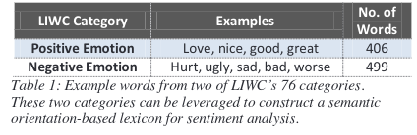
4. Sentiment Classifier
(VADER)
Valence Aware Dictionary for Sentiment Reasoning
Lexicon and rule-based sentiment analysis tool specifically tuned for social media.
Valence Score
A score assigned to the word under consideration by means of observation and experiences rather than pure logic.
-4
0
4
C.J. Hutto and E. Gilbert, "VADER: A Parsimonious Rule-Based Model for Sentiment Analysis of Social Media Text,"
in Proceedings of the International AAAI Conference on Weblogs and Social Media, vol. 8, no. 1, 2014. [Online]. Available: https://ojs.aaai.org/index.php/ICWSM/article/view/14550/14399

Slide 30
Heuristics
Sentiment Lexicon:
"This movie is amazing!"
(Positive sentiment due to the word "amazing".)
Intensity Modifiers:
"This is really awesome!"
(The word "really" boosts the positive sentiment.)
Conjunctions:
"The plot was good, but the characters were unconvincing."
(The conjunction "but" shifts the sentiment.)
Punctuation Emphasis:
"I loved it!!!"
(Multiple exclamation marks increase the sentiment intensity.)
Capitalization:
“This was the WORST movie ever."
(Capitalization indicates strong negative sentiment.)
Negations:
"I didn't hate it."
(The negation "didn't" flips the sentiment to be less negative or neutral.)

Slide 31
5. Market Trend Sentiment Classifier

Slide 32


5. Market Trend Sentiment
Simple yet effective way to gauge market sentiment from financial news articles, tweets, or analyst reports by analyzing the frequency of specific optimistic (bullish) or pessimistic (bearish) words.

Slide 33

5. Market Trend Sentiment
More bullish words
Input Text
count
Equal proportion of words associated with each trend
More bearish words

Slide 34
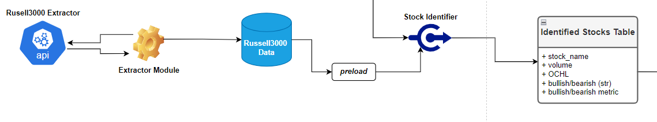
6. Stock Identification
Input: WSB Subreddit documents (with light to no preprocessing)
Output: Identified stock tickers, weighted by market volume.
Methods:
Russell3000 extractor script
Heuristic + regex-based methods
Yahoo finance API

Slide 35
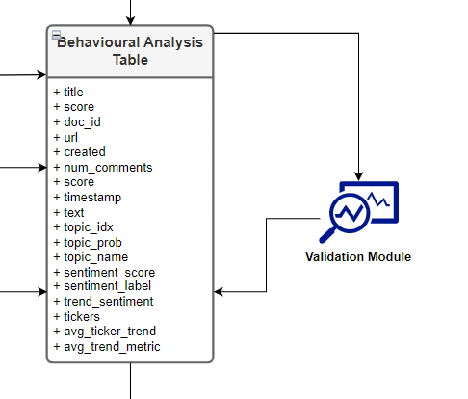
7. Aggregation
Wallstreetbets fetched API data
Assigned topics per reddit (topic name, probability)
Reddit sentiment score & label (negative, neutral, positive)
Reddit trend analysis (bearish, neutral, bullish)
Identified reddit tickers
Aside: Validation module

Slide 36
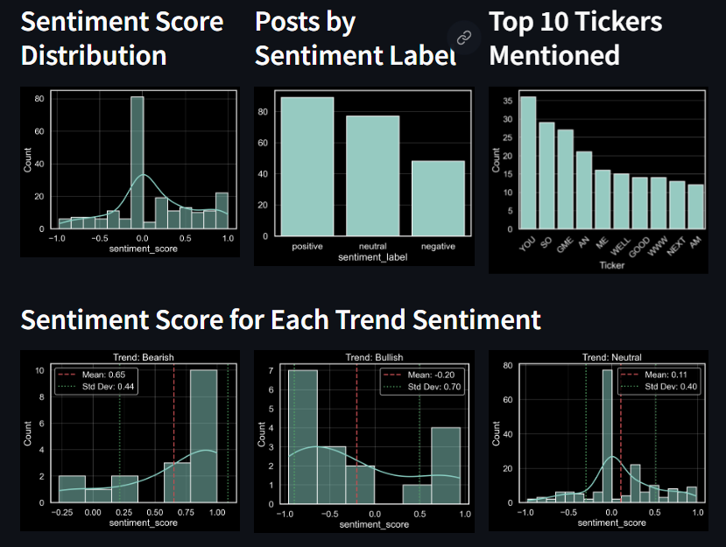
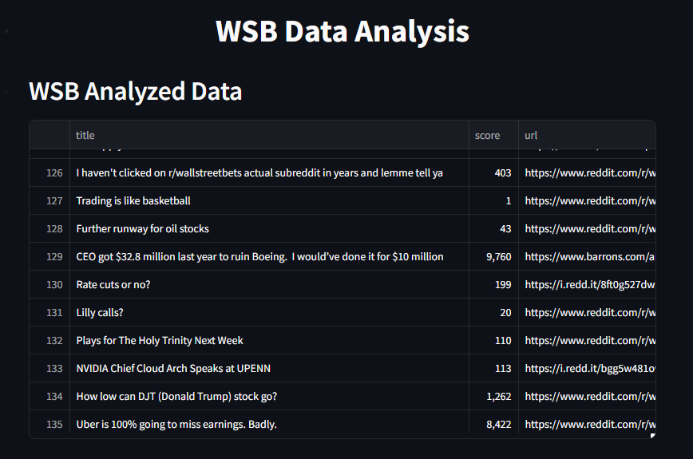
8. Dashboard & Analytics

Slide 37
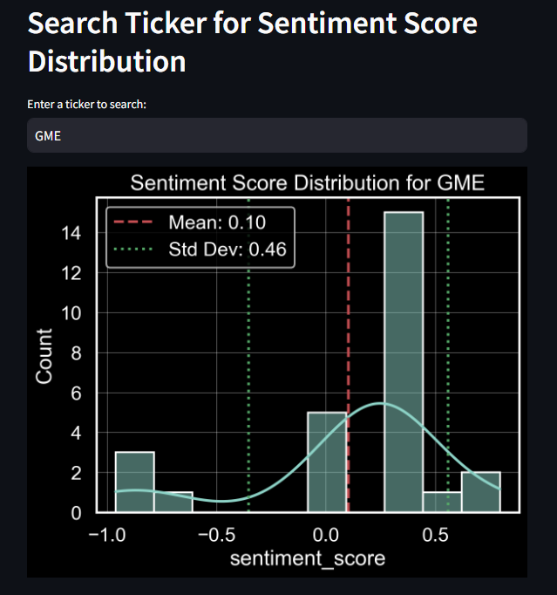
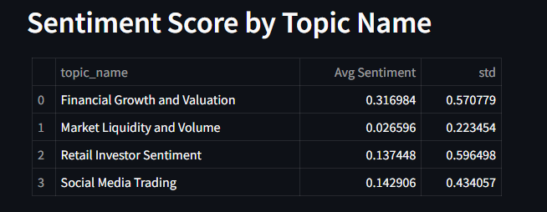
8. Dashboard & Analytics

Slide 38
Architecture

Slide 39
Demo

Slide 40
Questions?

